Slide 1
Lifelong Learning – Learning Beyond The Classroom
By: Ho Bing Hui U1721376E
Notes:
Good afternoon Prof Tang and Dr Michelle, today I will be presenting my FYP project, Learning Beyond the classroom.

Slide 2
Content
Introduction
Technology stack
Planning
Key Product Features
Challenge Faced
Future Improvements
Notes:
Firstly, it is the introduction where I will talk about the motivation and objective of the project.
The technology stack that I used for my project
Planning which is the preparation work that I did before I started developing
Key product features that addresses my objectives
One main challenge that I face during my project
Future improvements that ca be made

Slide 3
Introduction

Slide 4



Motivation
Lifelong learning is a self-initiated education that focus on personal development.
Courses are usually for short period of time
There is not much follow up
Notes:
Lifelong learning is a self-initiated education that focus on personal development. There are many places that provides such external courses be it physical or online.
However, most of these courses are over a short period of time and it is debatable whether the learners will pick up fully or have the opportunity to use the knowledge.

Slide 5



Objectives
Promote communication and learning
Supplement physical lessons
Encourage active learning
Notes:
Therefore, my fyp project aims to create a platform that aims to promote continuous communication and learning, to supplement physical classes and encourage active learning.

Slide 6
Technology Stack
Notes:
What are some of the technology I will be using for my application?

Slide 7
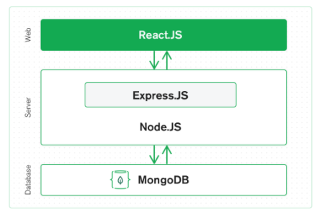
Architecture
Front-end
Back-end
Database
Notes:
A web application will have a basic architecture that consist of 3 parts
the front-end, The front-end of the website is the part where the user interacts with. It usually focusses on user experience and responsiveness.
back-end: where most processing logic is carried out.
and database. Which is to store the data required or used by the application.

Slide 8

Front-End Development
Able to create reusable codes and components
Ease of maintenance
Single Page Application
Notes:
When developing the frontend, we will use a frontend framework. For my case, I used vuejs.
Using a frontend framework can make development much easier and faster as it is able to create reusable components and code thus minimizing code repetition. It also makes maintenance work much easier.
We can also built a SPA using the chosen framework.

Slide 9
Single Page Application
A popular web design principle
Dynamically update the page through a virtual DOM
Ensure a better user experience
Notes:
SPA is a popular web design principle. It dynamically updates the page through a virtual dom instead of loding an entire new page.
This makes navigating through the application more seamless and quicker thus a better user experience
Virtual Document Object Model is a lightweight javascript representation of the website. Changes can be made to the virtual DOM first before rendering it onto the screen.
Changes made in virtual dom is faster as nothing needs to be rendered first.

Slide 10
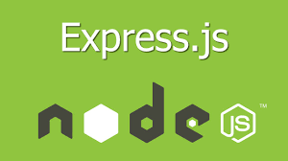
Back-End Development
Contains the processing logic of the application
Manages user connection and authentication
Serve as a middleman between the database and the front-end
Notes:
For the back-end, I used ExpressJS which is a minimalistic framework (barebone, flexible and does not enforce a fix architecture).
The back end is where all the processing logic will be carried out. Authentication will be carried out here to ensure that our web application can only be accessed by registered user.
It also serve as a middleman between the front and the database.

Slide 11

Database
MongoDB is a NoSQL database. It is a document type database and store data in JSON like documents.
Notes:
The database I use for my project is mongoDB.
Mongo is a non relational database and is a popular database for web development as it store and save data in JSON like documents which is much more expressive and powerful as compared to traditional column and row database.
Supports flexible and dynamic schema, supports array and nested objects.

Slide 12
Planning
Notes:
Before I start development, I need to have a better overview of how my application will look like, what functions are required and how the structure of the application will be like.
Therefore,….

Slide 13
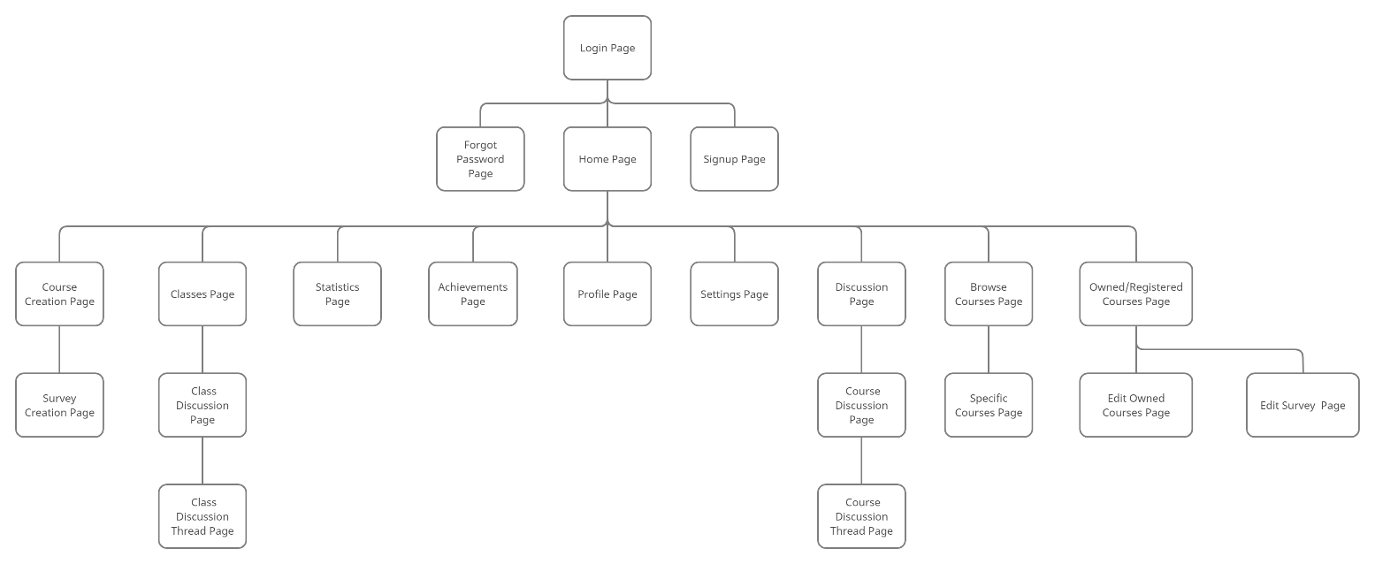
Sitemap and logic design
Notes:
I started of creating the sitemap of the application.
It consist of all the required pages, and we can see how each of them is connected.

Slide 14

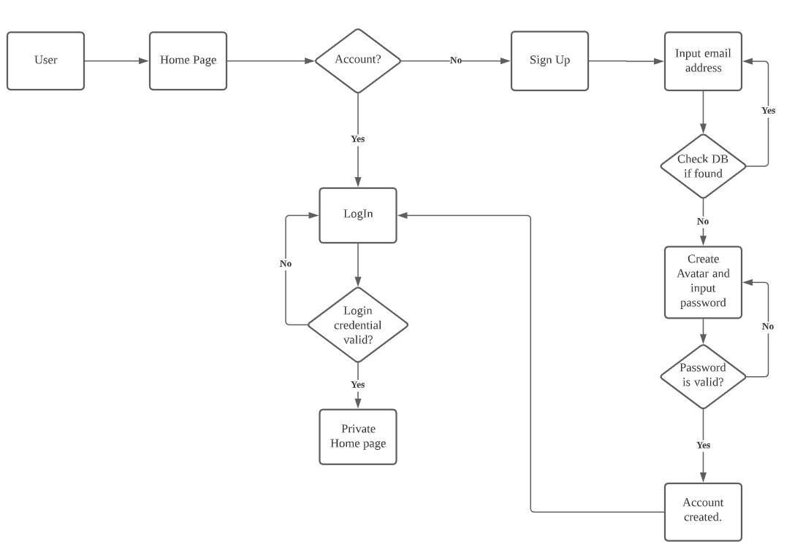
Sitemap and logic design
Notes:
This is the logic design of the login and sign up section.
As our applications requires an account, we need a logic flow to help check if the user have an existing account, if not how he should do.

Slide 15
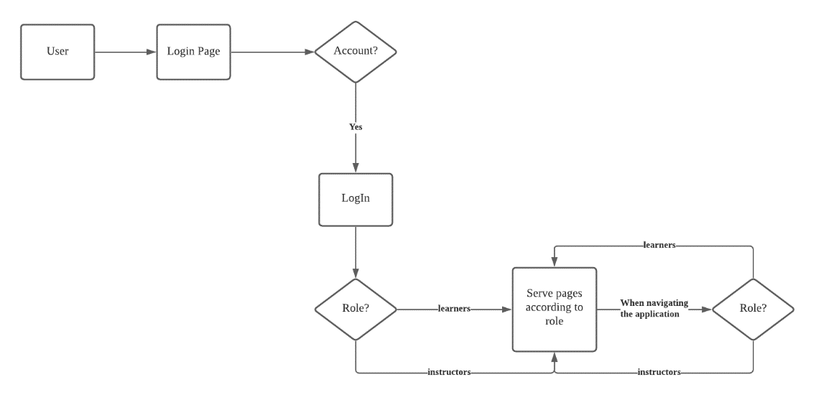
Sitemap and logic design
Notes:
Next, this logic design is an overview of how the user will log in and navigate the application.
As there are 2 main users on the platform: learners and instructors, the application needs to decide which content should be displayed to the users' base on their role.
This logic map show that base on the type of users, the content serve will be different. This is mainly for pages where the learners and instructors have differing functions.

Slide 16
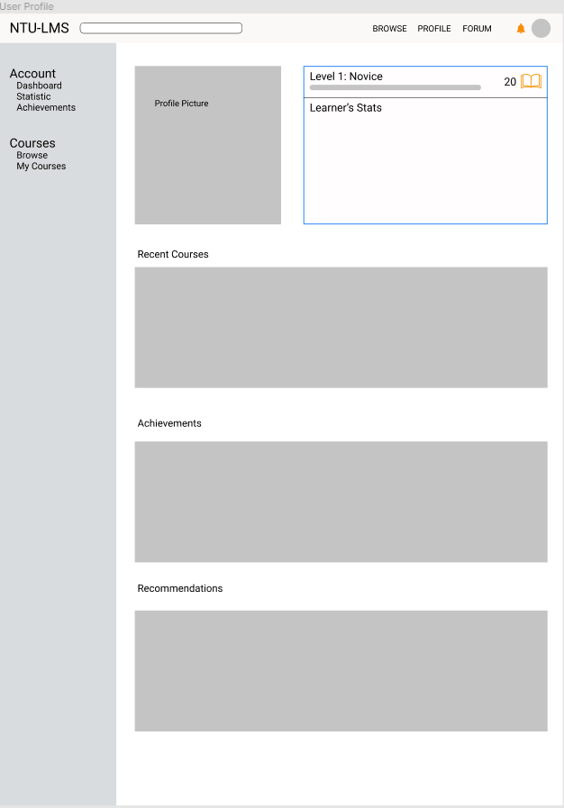
User Interfaces
Notes:
I also drafted a rough design for the user interface. This gives me an idea of how the website is going to look like and I started developing.
I mainly focus on the layout of the design such as the position of the navbar or topbar. This layout will be the same for all the other pages.
Throughout the development phase, I change the layout design a few times to see which one works the best.

Slide 17
Functionalities
Common Functionalities
Learner’s Functionalities
Instructor’s Functionalities
Administrator’s Functionalities
Notes:
Next, I also listed the functionalities that I want in my application. To make it simpler, I divided the functionalities into different groups as seen in the slide.
By doing so, I am able to determine how I want to structure my code so that it will serve the correct content base on the user type and also prevent me from missing out key functions.

Slide 18
Key Product Features
Notes:
After all planning and building the application, I would like to go through some key features that were created to target the issues that I brought out in my objectives.

Slide 19
Encourage Continuous Learning & Communication
Notes:
The first objective is to create a community so that discussion of the related topics can continue even after the course have ended. This helps to promote continuous learning and help users to recap their learnt skills and knowledge.

Slide 20
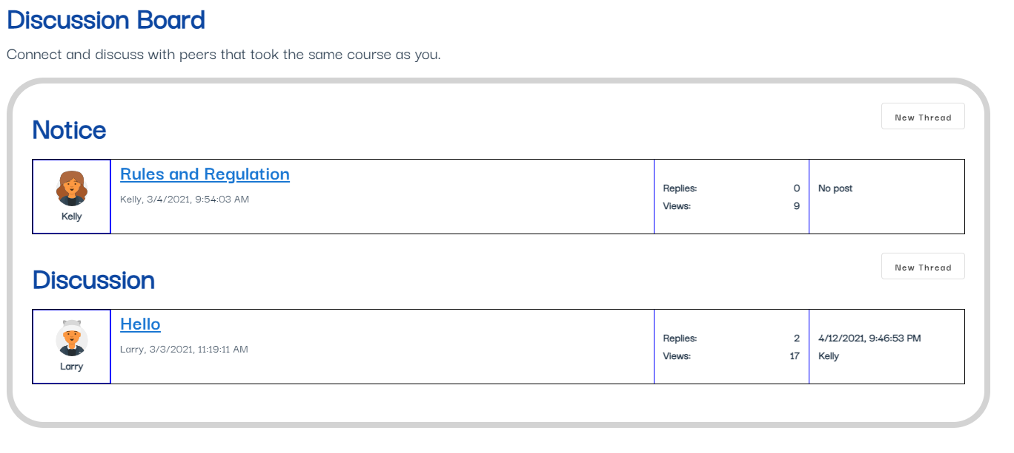
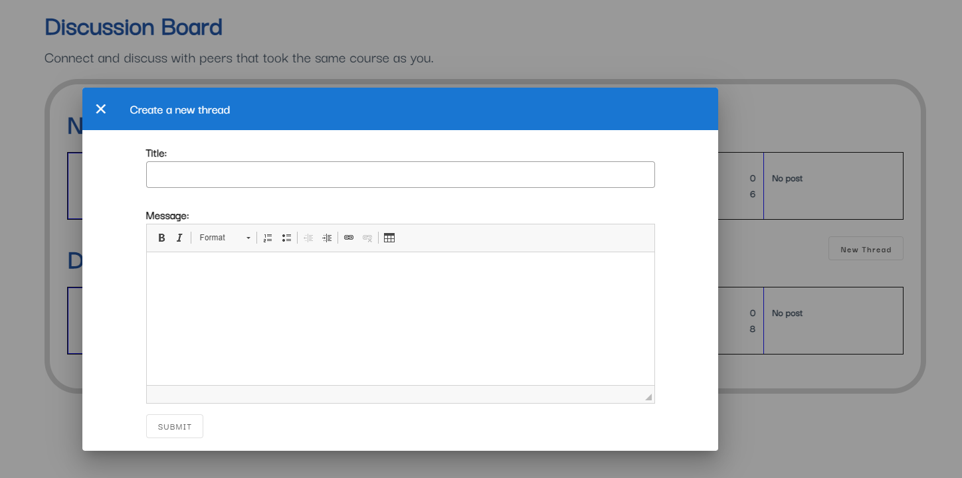
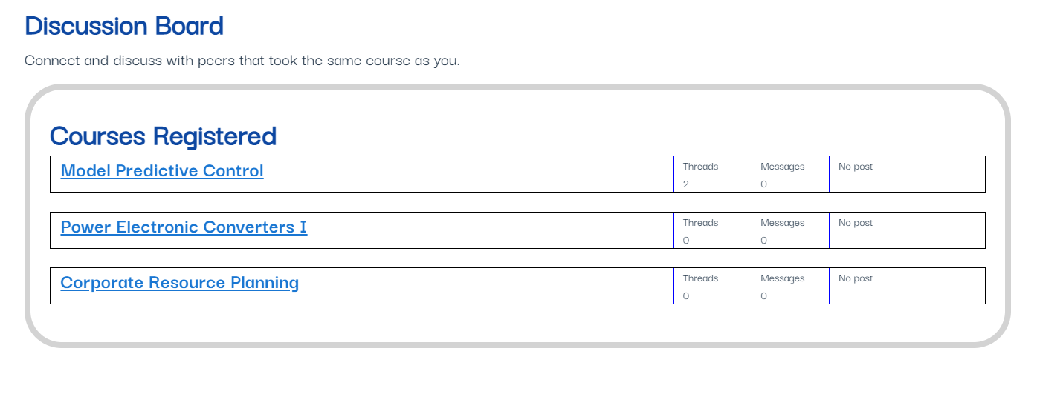
Discussion Board
Notes:
I created a forum style discussion board where users that have taken the course can access. Here, I aim to create a community of users that will enable them to exchange knowledge by asking and answering questions.
Here, they can access the discussion board of courses that they have taken.
Accessing them, they can view a list of ongoing discussion or create their own.
By clicking on the create thread button, a pop up will appear and they can create a topic to discuss.

Slide 21
Supplement Physical Classes
Notes:
Next objective is to supplement physicals classes in a way to support the instructors or to make the class more efficient.
Supplement physical classes by providing an avenue for instructors to collect specific feedbacks from the learners.

Slide 22
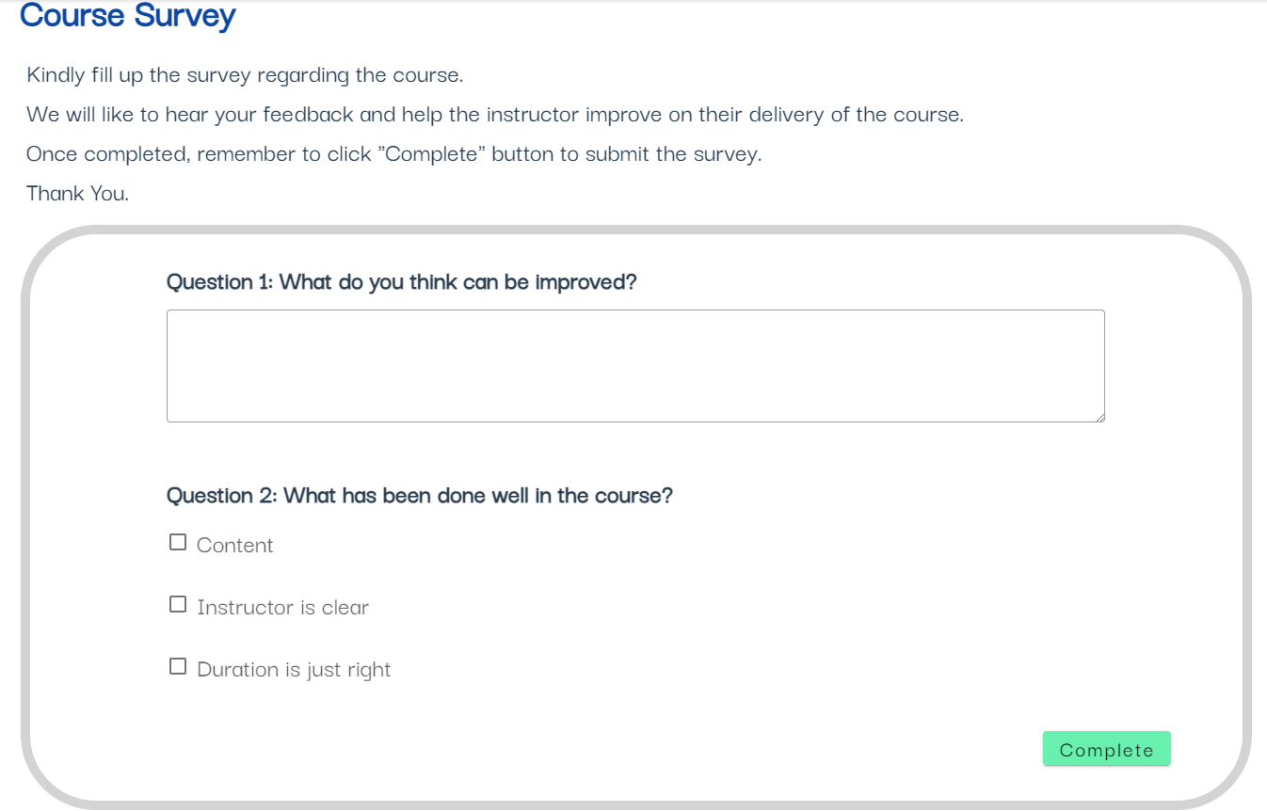
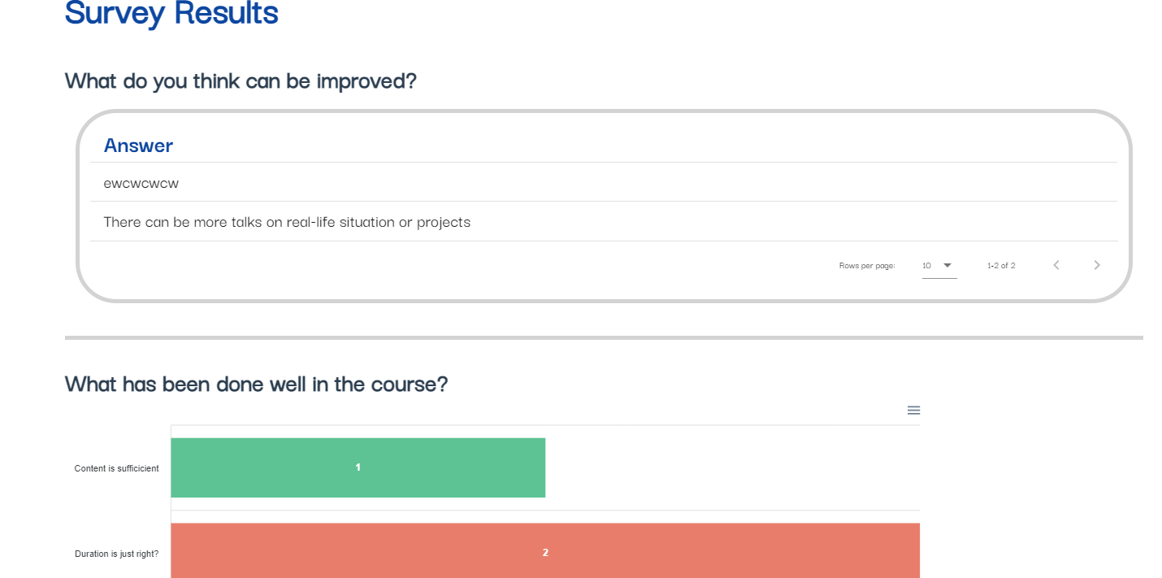
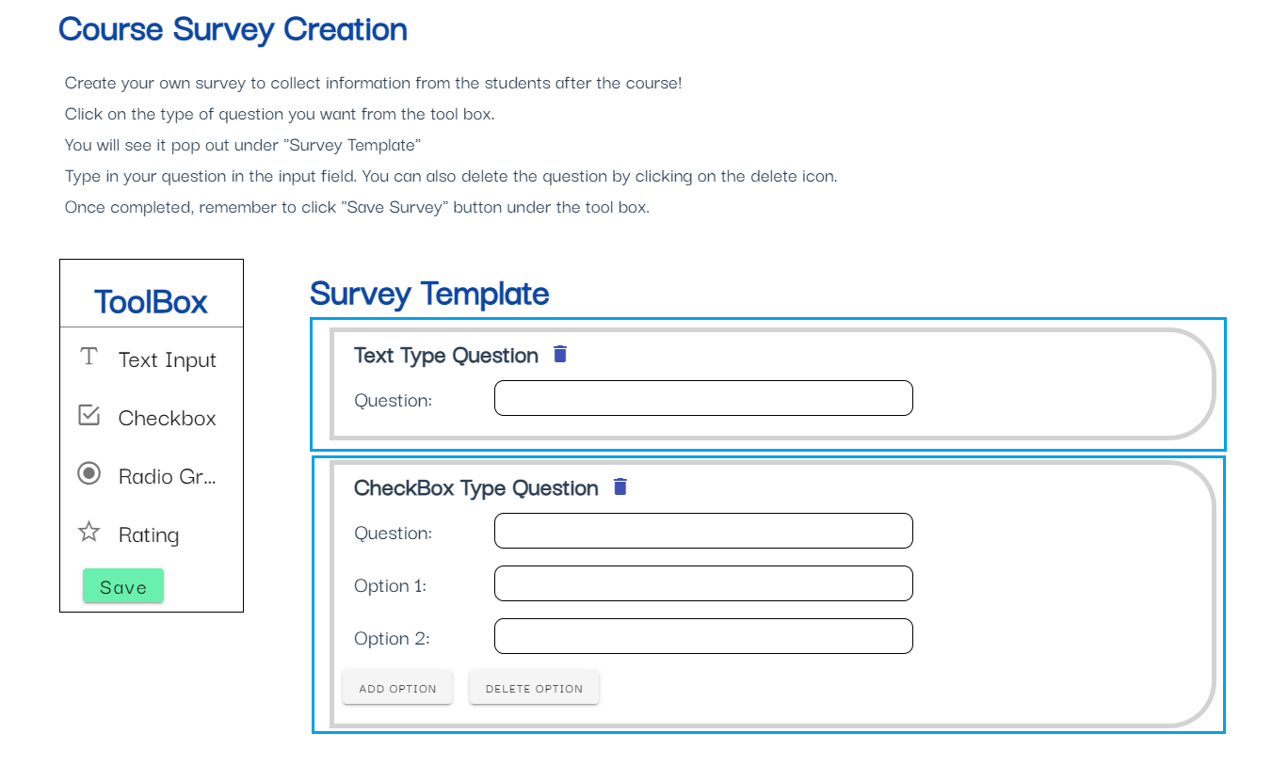
Survey Components
Notes:
A survey component that allows instructor to create a survey to collect feedback from the students at the end of the class.
Here, the instructors can create a survey as seen in the diagram.
Users that took and completed the course will be able to access the survey and complete them.
Instructors can then see the results of the surveys completed.

Slide 23
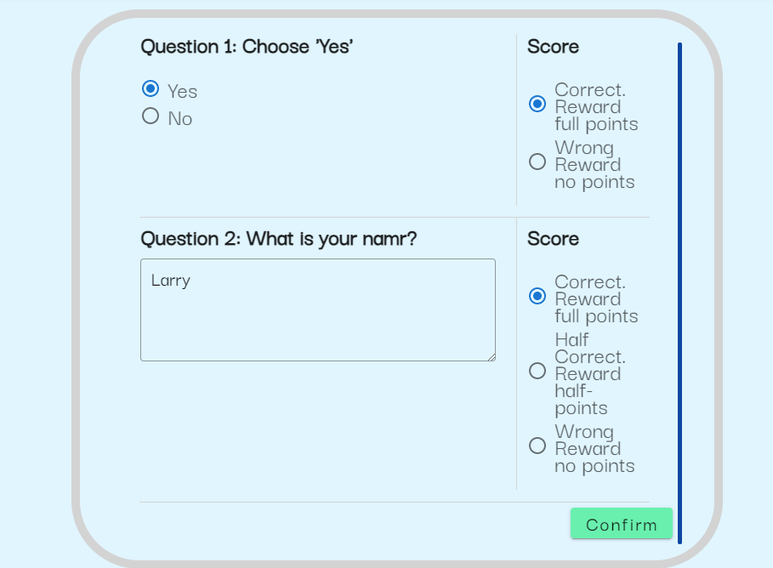
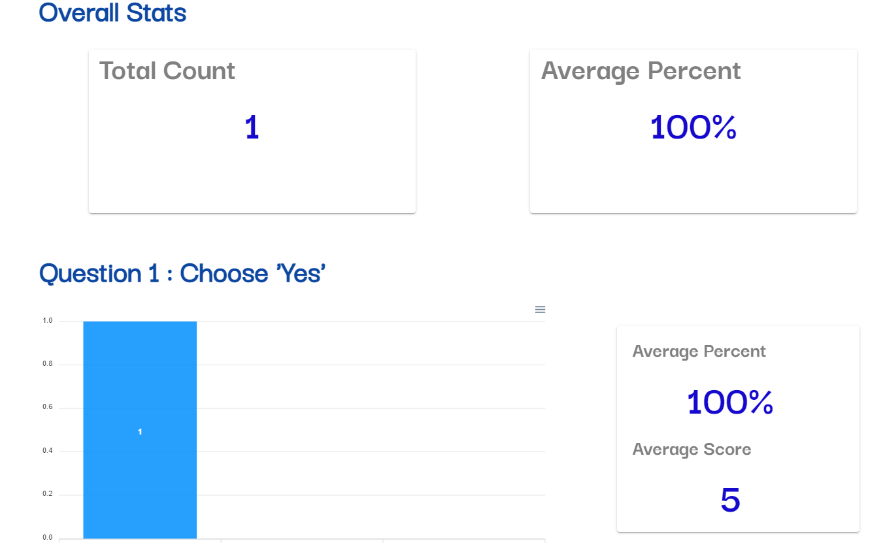
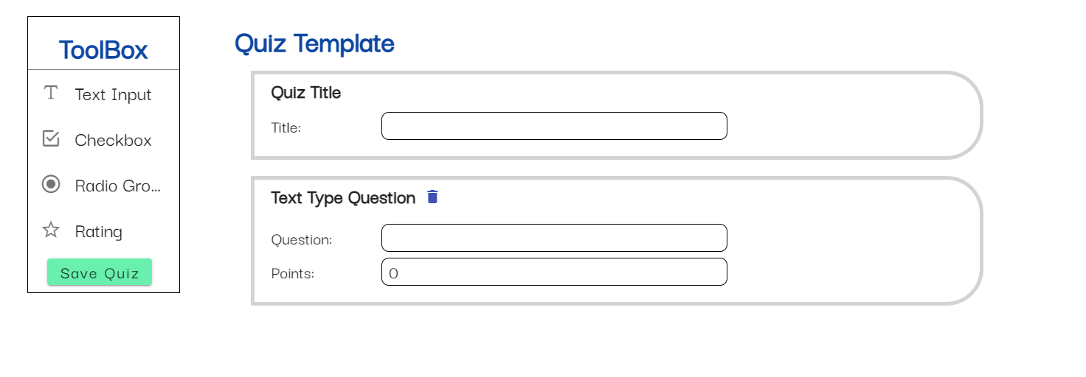
Quiz Components
Notes:
Instructors can also create a quiz assignment in the class board. It is similar to creating a survey.
Instructors can also mark the quiz through the application and view the quiz statistic.
The statistic will display the average percentage score for the quiz and for each individual question.

Slide 24
Encourage Active Learning

Slide 25
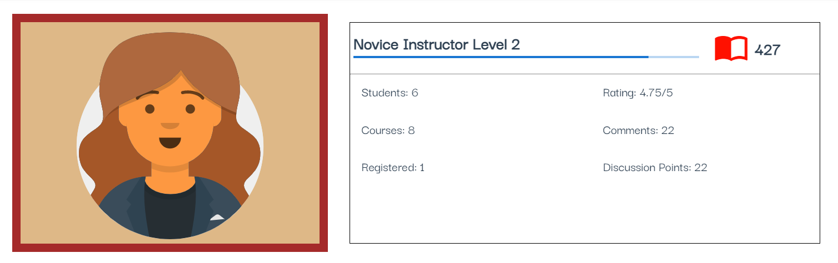
Level & Point System
Notes:
On the application, users can obtain points as they carried out activities. For example, by posting in the discussion forum or completed the courses.

Slide 26
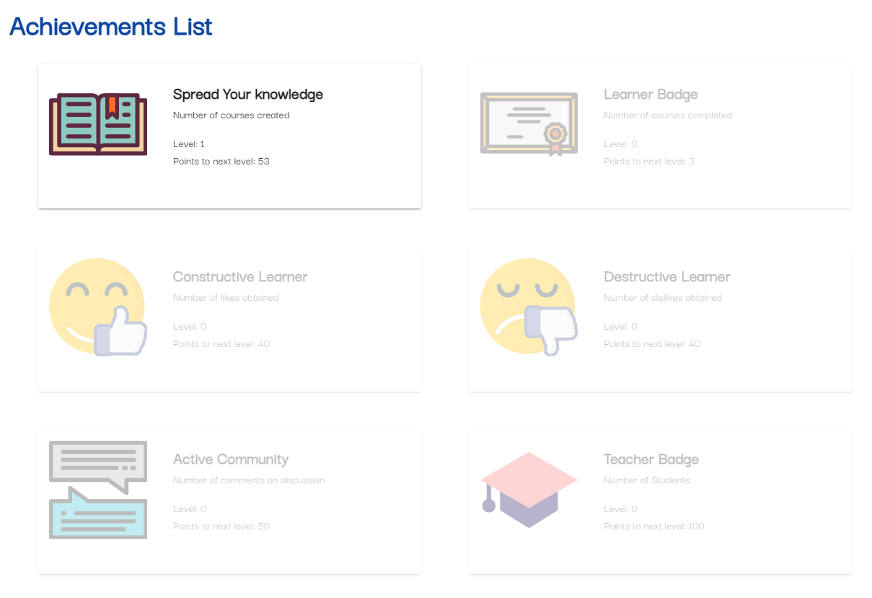
Achievements
Notes:
Some of the points obtain can be correspond to the achievements. The purpose of having the achievements is to motivate users to stay on the platform and be active in learning new courses or in the discussion board.

Slide 27
Challenge Faced

Slide 28
Creating the Survey Components
Allow instructors to add or remove questions
Data should be structured and stored
To display the data results
Notes:
One of the main challenge faced by me was creating the survey components.
At first, I used a survey library for this. However, due to the restriction on the library such as the subscription fees etc, I was advised to create it myself instead.
To create it, I have think about how to allow users to add and remove question during the creation phase.
How the data should be structured and stored such that it is more efficient.
Finally I have to think about how to display the question statistic individually.

Slide 29
Future Improvements
Notes:
Even though I have completed my FYP project, there are still much room for improvements. I will list out 3 main improvements that can be done in the future.

Slide 30






Incorporating Virtual Alternatives
Notes:
First, we could incorporate virtual alternatives be it conducting virtual lesson through zoom or online videos classes like Udemy. Virtual alternatives can be beneficial as it provides a more flexible learning environment.
Due to other commitments or situation like the pandemic, users might not be able to make it for the time slot provided but a virtual lesson might help solve the problem.

Slide 31


Providing E-Certification
Notes:
Another improvement to be made can be to include a e-certificate for the completion of the course like those in coursera. This certificate can then be added to their linkedin profile to make job hunting easier.
Providing a recognizable certificate will make users more incline to take up the courses as it will be useful in their resume.

Slide 32
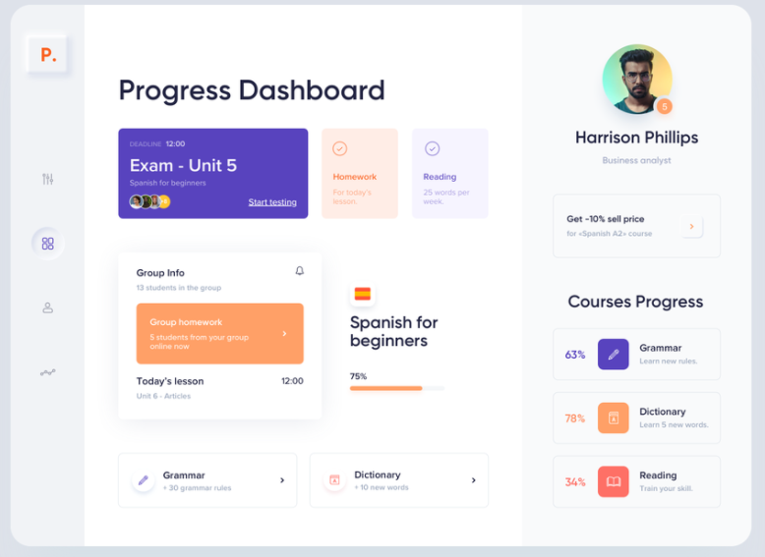
Improving On User Interface
Notes:
Lastly, I believe more work can be put into designing the application. The attractiveness of the user interface can also attract users to the platform.

Slide 33
Thank You

